Slide 1
Generative Artificial Intelligence and Ethics
Felix Gonzalez, P.E.
felix.gonzalez@gmail.com
fgonzaleumbc/DATA601

Slide 2
Generative Artificial Intelligence (AI)
Generative Artificial Intelligence(AI): technologies that generate an output (i.e., unimodal or multimodal) based on user prompt (i.e., typically text).
Text
Photo
Sound
Video
One characteristic of Generative AI is the use of very large datasets and may take millions of dollars to train a model depending on amount of data being processed.
Examples of text datasets commonly used for large language models (LLM) training:
Common Crawl: vast amount of web text data (2.8 billion web pages, 410 TiB of data as of September 21, 2024)
Wikipedia: structured articles on many topics

Slide 3
Large Language Models (LLM)
Examples of LLMs:
Generative pre-trained transformer (GPT)
Large Language Model Meta AI (LLaMa)
OpenLLaMa: Open reproduction of LLaMa
Text-to-Text Transfer Transformer (T5)
Example of Commercial Gen AI tools:
Open AI ChatGPT
Microsoft Copilot: https://copilot.microsoft.com/
Google Gemini: https://gemini.google.com/app

Slide 4
Generative AI and Other Technologies
Gen AI outputs are being integrated and embedded into applications
Search engines seem to be integrating Gen AI outputs in results (e.g., Google)
Review sites integrating an AI generated overview (e.g., Amazon)
Generated AI outputs may be noted
Retrieval-Augmented Generation (RAG) framework allows integration of LLMs and internal data (e.g., search engine index, reviews, etc.)

Slide 5
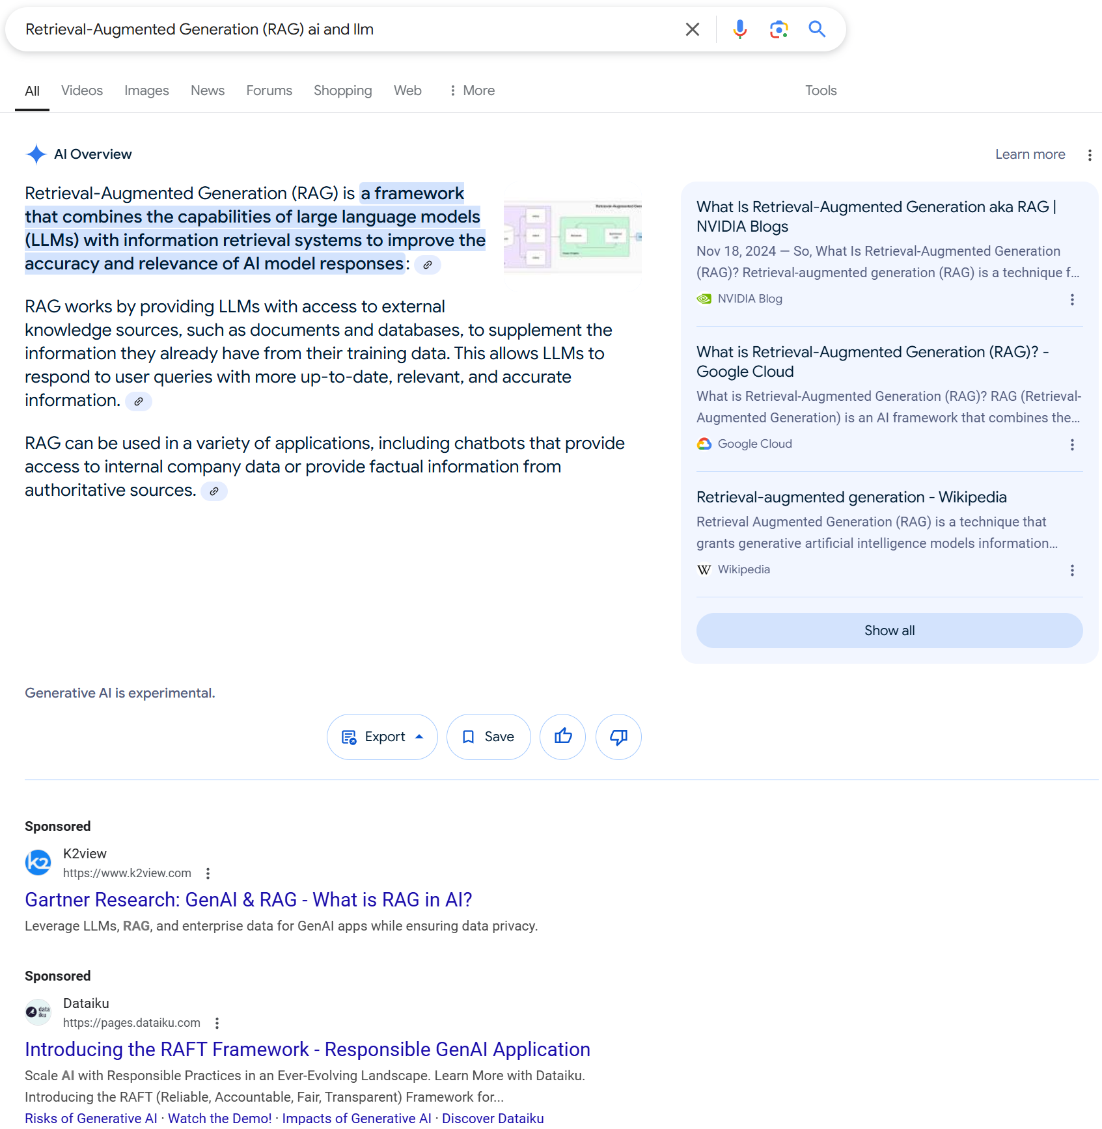
*Google.com search engine results
Query on 12/27/2024

Slide 6
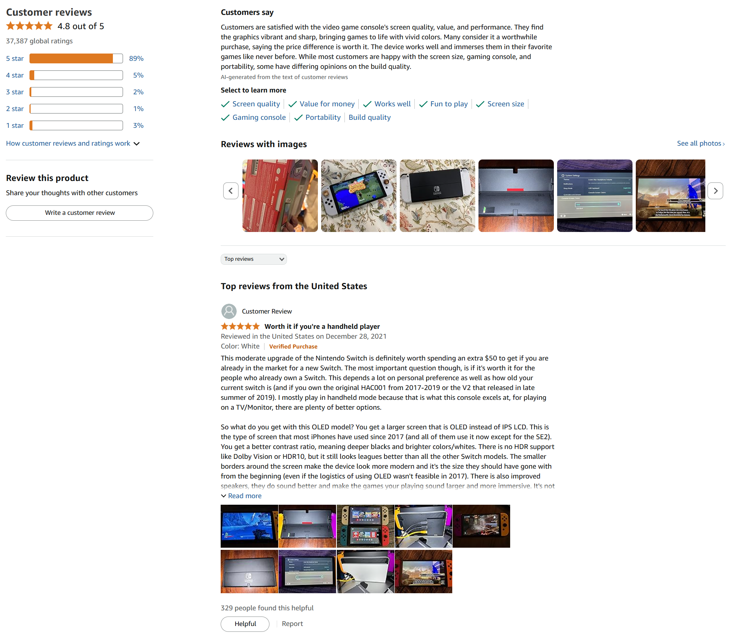
*Amazon Product Review
Query on 12/27/2024

Slide 7
Generative AI Precautions
Utilize same precautions as when using any internet search engine or other commercial applications (e.g., do not use non-public data, personal information, etc.)
Follow Prompt engineering current best practices
Consider Generative AI outputs may be inaccurate (e.g., hallucinations), may be unfair, and contain biases
AI generated output should have notice
Output may be different depending on the date of prompt/query
Consider that model may have issues related to rights, safety, and Ethics
Do not rely solely on Generative AI outputs

Slide 8
Prompt Engineering Best Practices
Best Practices:
Be specific (e.g., provide details on length, style, format, sections, and other details expected on the output)
Provide examples if possible
Keep it simple
Give the tool an out: For example, in the instructions write: “respond not found” if the answer isn’t present.
Test and refine
Prompt Engineering References:
https://learn.microsoft.com/en-us/training/modules/create-prompts-for-generative-ai-training-tools/
https://learn.microsoft.com/en-us/microsoft-copilot-studio/nlu-generative-answers-prompt-modification
https://platform.openai.com/docs/guides/prompt-engineering/strategy-write-clear-instructions
https://www.deeplearning.ai/short-courses/chatgpt-prompt-engineering-for-developers/

Slide 9
Generative AI Detection
Tools that detect probability of text being AI Generated.
Gptzero: https://gptzero.me/
Quillbot: https://quillbot.com/ai-content-detector
Accuracy of Generative AI detection tools may vary singificantly:
False positive rate is important as may tag text as generated by AI when it was not:
https://pmc.ncbi.nlm.nih.gov/articles/PMC10519776/
In academics, these tools are being used for identification of plagiarisms

Slide 10

Questions?

